Slide 1

How to run NPCdApp 1.0 NEO Testnet: 0x7074acf3f06dd3f456e11053ebf61c5b04b07ebc Submission to the CoZ dApp Competition #2 Closing date: February 24, 2018
NEO Community TechNote
Michael Herman
https://github.com/mwherman2000/neo-persistibleclasses
mwherman@parallelspace.net

Slide 2
What is NPCdApp 1.0?
NPC
NEO Persistable Classes
Long name: NEO Persistable Class (NPC) Framework 1.0
Byline: An Efficient Object-Oriented Framework for C#.NEO Smart Contract Development
NPCdApp 1.0 is a C#.NEO smart contract dApp built for the CoZ dApp Competition #2 (closing date: February 24, 2018) to demonstrate NPC’s
Unique object-oriented programming style for C#.NEO smart contract development
Layered entity persistence model

Slide 3
Unique Object-Oriented Programming Style
Point p4 = Point.New();
Point.Set(p4, 10, 20);
Point.Log("p4", p4);
for (int index = 30; index < 40; index++)
{
NeoTrace.Trace("index", index);
Point.Set(p4, index, -index);
Point.PutElement(p4, vau, index);
}
for (int index = 30; index < 40; index++)
{
Point.Set(p4, index, -index);
Point x = Point.GetElement(vau, index);
Point.Log("loop.x", x);
if (Point.GetX(p4) != index || Point.GetY(p4) != -index)
{
msg = ">>>>(x,y) are different";
NeoTrace.Trace(msg);
break;
}
}

Slide 4
Layered Entity Persistence Model
Point p4 = Point.New();
Point.Set(p4, 10, 20);
Point.Log("p4", p4);
for (int index = 30; index < 40; index++)
{
NeoTrace.Trace("index", index);
Point.Set(p4, index, -index);
Point.PutElement(p4, vau, index);
}
for (int index = 30; index < 40; index++)
{
Point.Set(p4, index, -index);
Point x = Point.GetElement(vau, index);
Point.Log("loop.x", x);
if (Point.GetX(p4) != index || Point.GetY(p4) != -index)
{
msg = ">>>>(x,y) are different";
NeoTrace.Trace(msg);
break;
}
}
See Appendix A of this PPT for more C#.NEO object-oriented programming examples

Slide 5
Running NPCdApp 1.0 with neo-debugger
Network: NEO Testnet
Source to build NPCdApp.avm for loading into neod.exe:
https://github.com/mwherman2000/neo-persistibleclasses/blob/master/NPCdApp/NPCdApp.cs
Use latest version of neo-debugger with new Storage viewer (F6) smart formatting support
Should be in https://github.com/CityOfZion/neo-debugger-tools/pull/48
Backup plan: https://github.com/mwherman2000/neo-debugger-tools
This version includes specific smart formatting support for NEO Storage Keys that in implement the new NEO-KONG NEO Storage Key format
NEO-KONG = NEO Key-Object Notation for Geeks
Calling Conventions
Prototype: Main( string operation, param objects[] )
Operations: “test1” | “test2” | “test3” | “test4” | “test5” | “test6”
ArrayOfObjects: [ 5 ] – only used by “test6” to control the maximum number of iterations
Results
Main will return “success”
The real results are available by pressing F6 to display the neo-debugger Storage viewer
The real results also include the messages in the Event Log panel (lower-left corner of neo-debugger)

Slide 6
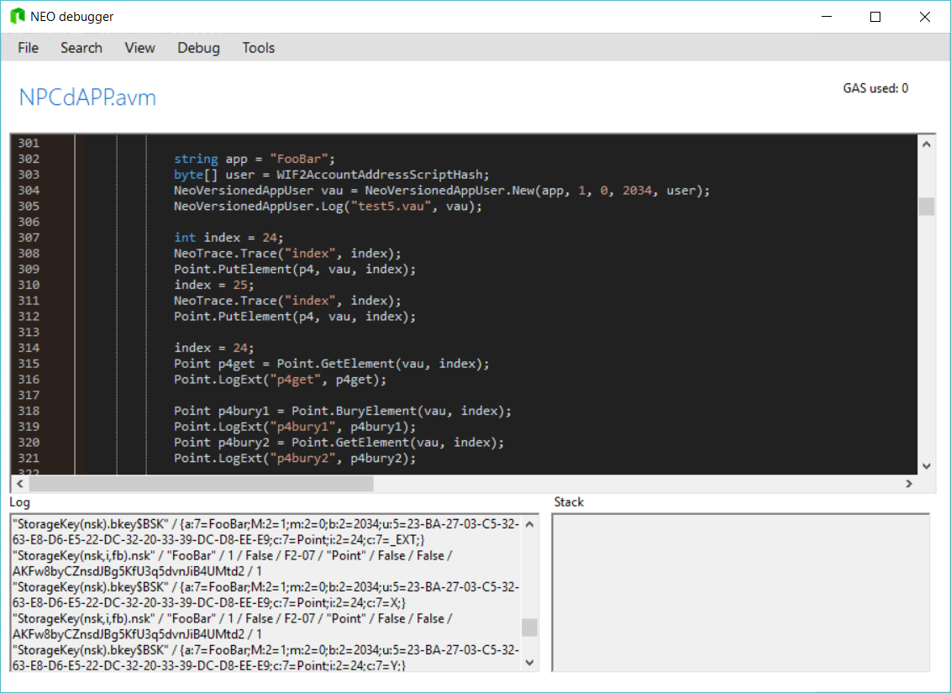
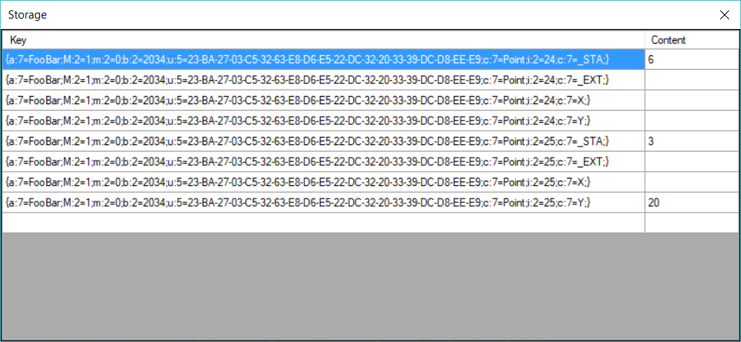
Running NPCdApp 1.0 with neo-debugger

Slide 7
Running NPCdApp 1.0 with neo-gui-developer
Network: NEO Testnet
NPCdApp SC Address: 0x7074acf3f06dd3f456e11053ebf61c5b04b07ebc
Use latest version of neo-gui-developer with new Event Log smart formatting support
Should be here: https://github.com/CityOfZion/neo-debugger-tools/pull/48
Backup plan: https://github.com/mwherman2000/neo-debugger-tools
This version includes specific smart formatting support for a range of NEO data types and key types
No direct support for NEO-KONG (yet) = NEO Key-Object Notation for Geeks
Calling Conventions
Prototype: Main( string operation, param objects[] )
Parameter Types: 0710
Operations: test1”| test2| test3 | test4 | test5 | test6
ArrayOfObjects: [ 5 ] – only used by test6 to control the maximum number of iterations
Results
Main will return “success”
The real results are the messages in the Event Log tab

Slide 8
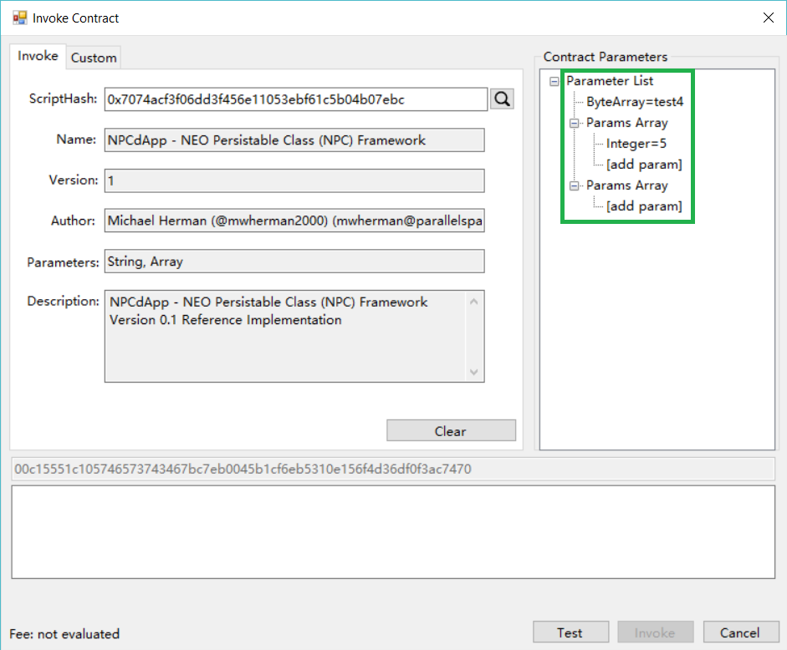
Running NPCdApp 1.0 with neo-gui-developer

Slide 9
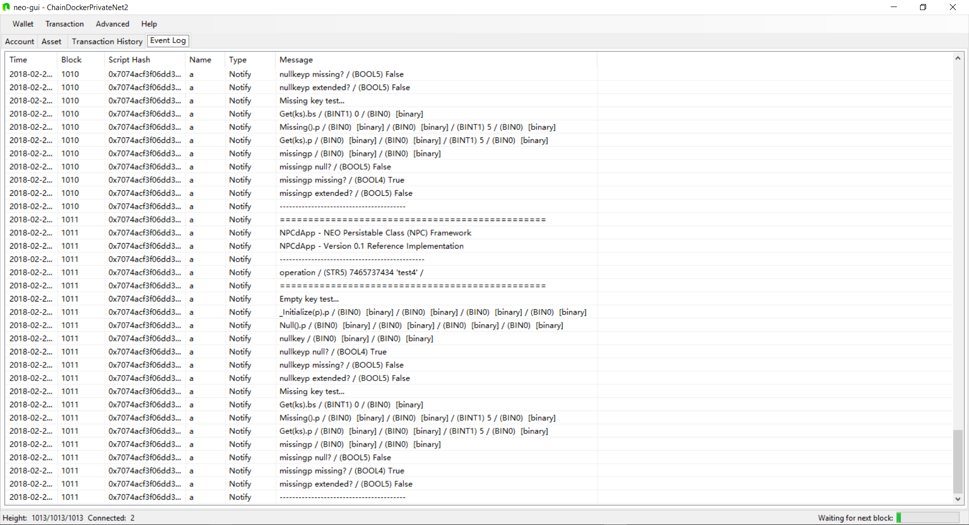
Running NPCdApp 1.0 with neo-gui-developer

Slide 10
Appendix A – Test Case Code

Slide 11
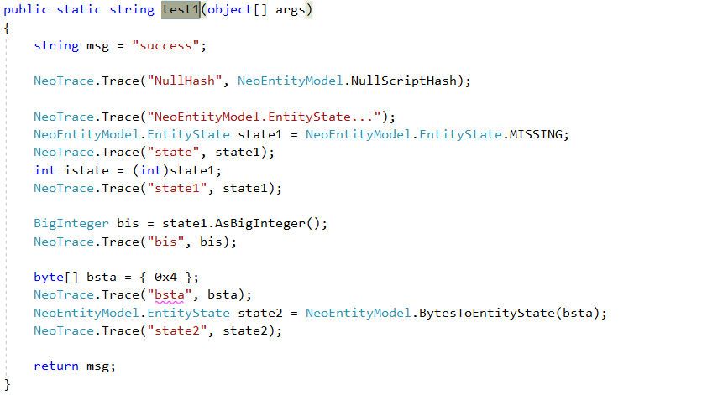
Test1() – Code

Slide 12
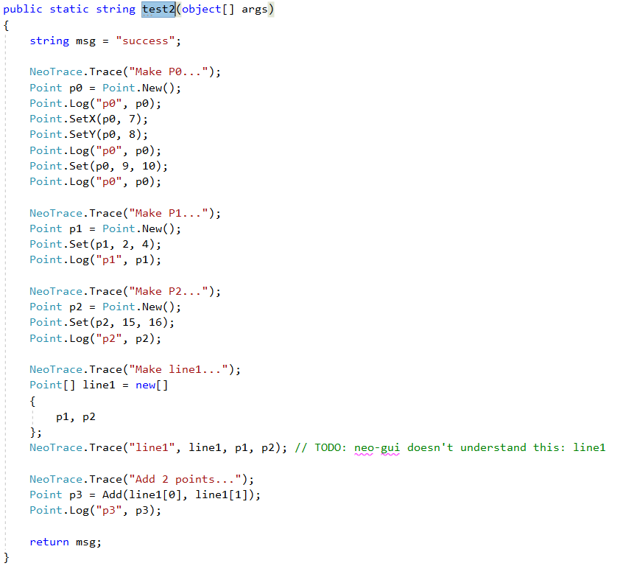
Test2() – Code

Slide 13
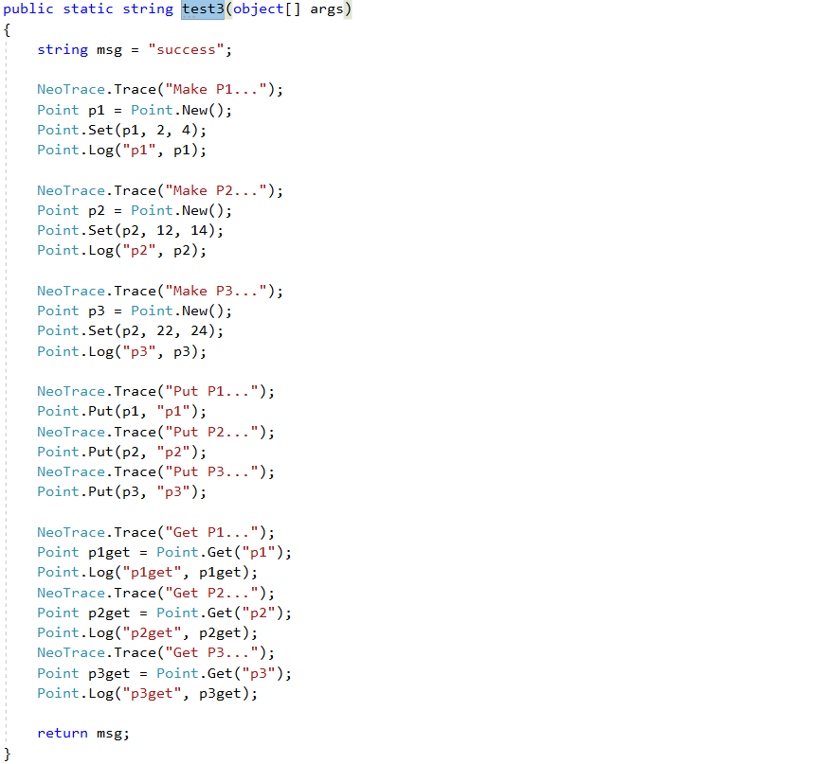
Test3() – Code

Slide 14
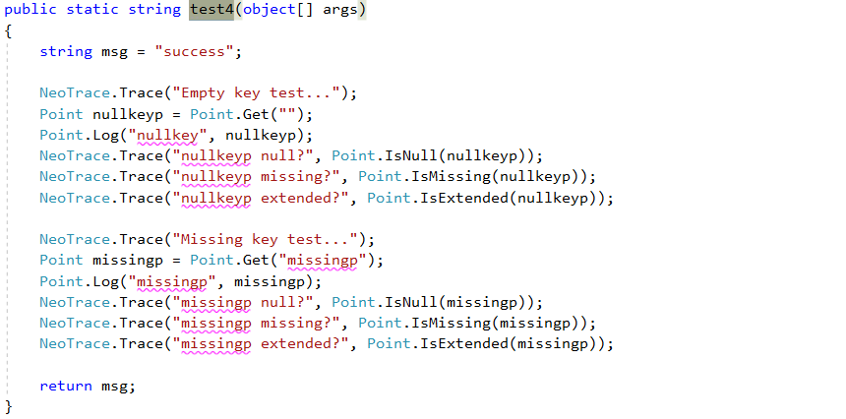
Test4() – Code

Slide 15
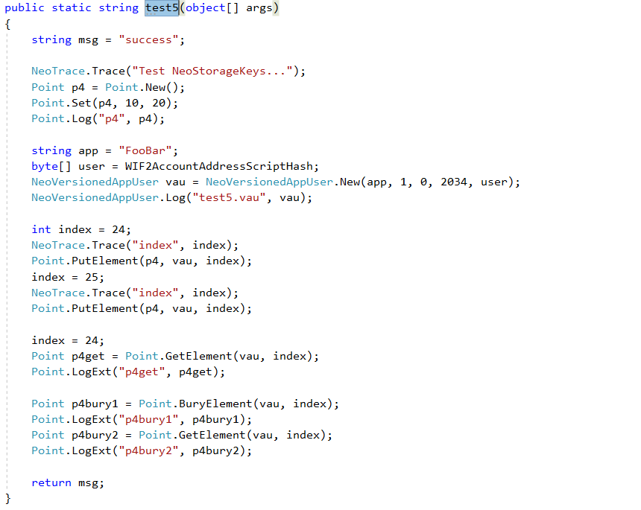
Test5() – Code

Slide 16
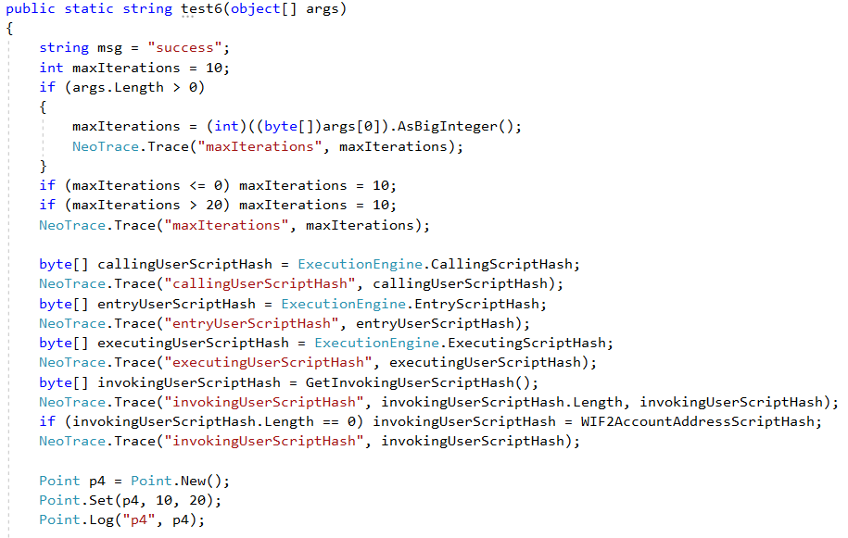
Test6() – Code

Slide 17
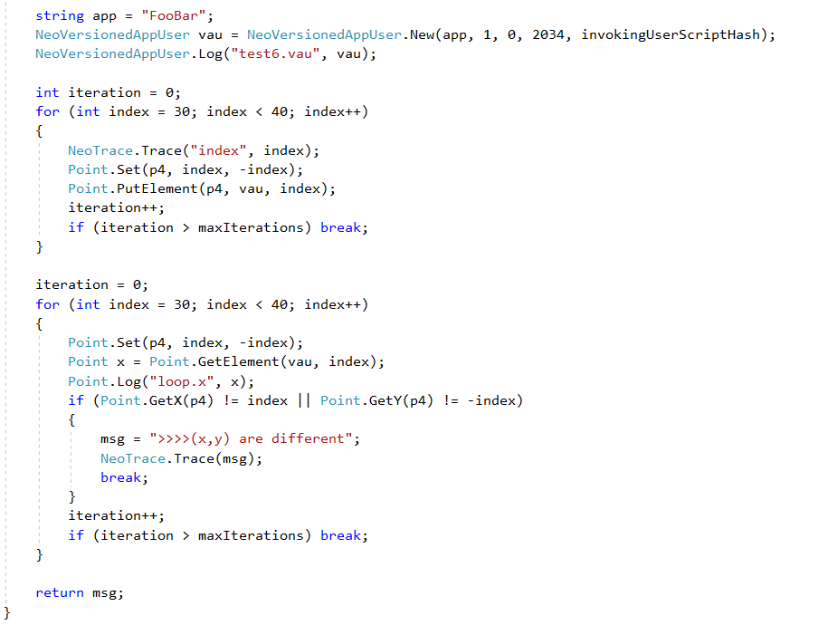
Test6() – Code (con’t)

Slide 18
Questions?
Discord: Michael Herman (Toronto)
Email: mwherman@parallelspace.net

